Slide 1

N A V I

Slide 2





Creators
Brandon Mack Gerone Hamilton Jr. J’nya Reese Ronté Parker
Notes:
Howard intro

Slide 3



Inspiration
People seeking new games
List of popular games
See reviews and comments
Save money
Have fun
Notes:
The idea for this app came from gamers in our group and around the Howard community that are always looking for a new games or finding highly reviewed games. We thought about what would be the best way to see top games, see some reviews, and see some comments about the game and what people think about it. Finding a new games can be difficult and if a game cost money you always want to be sure you’re buying the best product for your own entertainment and be able to enjoy it and have fun.

Slide 4
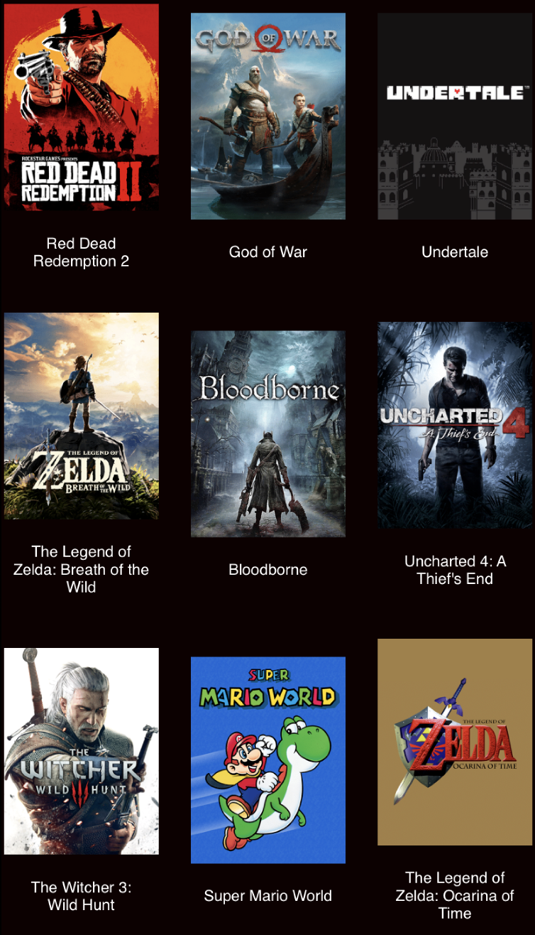
Solution
Game review app called Navi
Endless library of popular games
Easy to navigate
Ratings, Reviews, and Comments
API
Additional features
Notes:
We created a Game review app called Navi. In order to do this we wanted to be able to get a endless library of popular games that is easy to navigate games and have people rate and review them. Under the games description there is available space for ratings, reviews, and comments about the game. We also used an API for the list of games that are stored in our app. There are also some more additional features that we will touch on later.

Slide 5
Next Steps
In the future…
Amount of games
Allow users to see others profiles
Light and dark mode
Pull to refresh
Add game categories
But, this is what we were able to accomplish
Notes:
Brandon

Slide 6
App Demo
Notes:
Ronte

Slide 7
THANK YOU
Special thank you to the members of CodePath and the Tech fellows
Any Questions?

